Slide 1


agosto 2026
Lunes | Martes | Miércoles | Jueves | Viernes | Sábado | Domingo
 |  |  |  |  | 1 | 2
3 | 4 | 5 | 6 | 7 | 8 | 9
10 | 11 | 12 | 13 | 14 | 15 | 16
17 | 18 | 19 | 20 | 21 | 22 | 23
24 | 25 | 26 | 27 | 28 | 29 | 30
31

Slide 2
septiembre 2026
Lunes | Martes | Miércoles | Jueves | Viernes | Sábado | Domingo
 | 1 | 2 | 3 | 4 | 5 | 6
7 | 8 | 9 | 10 | 11 | 12 | 13
14 | 15 | 16 | 17 | 18 | 19 | 20
21 | 22 | 23 | 24 | 25 | 26 | 27
28 | 29 | 30

Slide 3
octubre 2026
Lunes | Martes | Miércoles | Jueves | Viernes | Sábado | Domingo
 |  |  | 1 | 2 | 3 | 4
5 | 6 | 7 | 8 | 9 | 10 | 11
12 | 13 | 14 | 15 | 16 | 17 | 18
19 | 20 | 21 | 22 | 23 | 24 | 25
26 | 27 | 28 | 29 | 30 | 31

Slide 4
NOVIEMBRE 2026
Lunes | Martes | Miércoles | Jueves | Viernes | Sábado | Domingo
 |  |  |  |  |  | 1
2 | 3 | 4 | 5 | 6 | 7 | 8
9 | 10 | 11 | 12 | 13 | 14 | 15
16 | 17 | 18 | 19 | 20 | 21 | 22
23 | 24 | 25 | 26 | 27 | 28 | 29
30

Slide 5
diciembre 2026
Lunes | Martes | Miércoles | Jueves | Viernes | Sábado | Domingo
 | 1 | 2 | 3 | 4 | 5 | 6
7 | 8 | 9 | 10 | 11 | 12 | 13
14 | 15 | 16 | 17 | 18 | 19 | 20
21 | 22 | 23 | 24 | 25 | 26 | 27
28 | 29 | 30 | 31

Slide 6

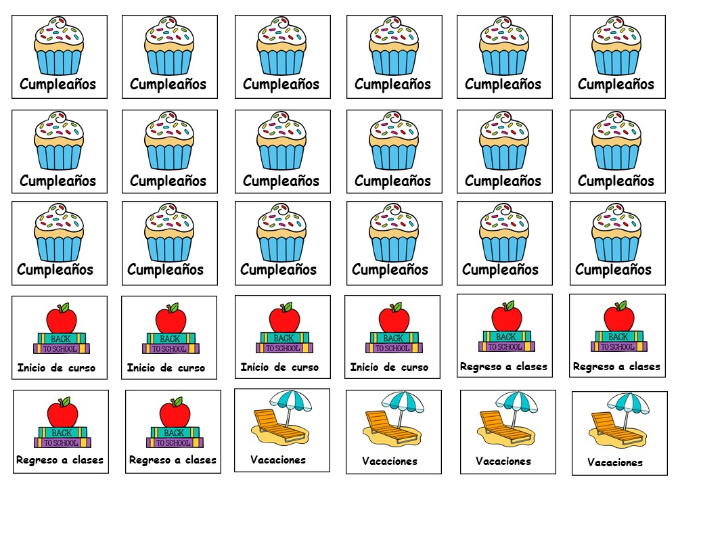

Slide 7
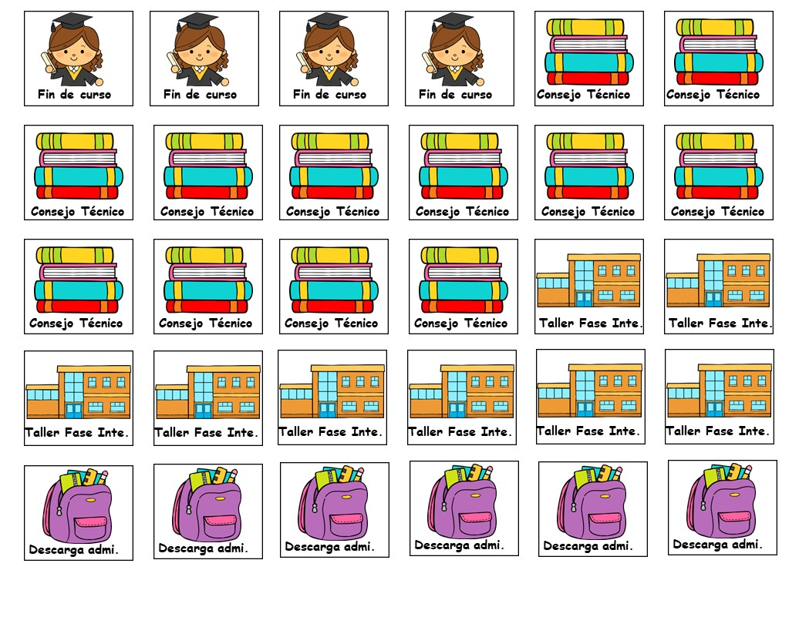

Slide 8
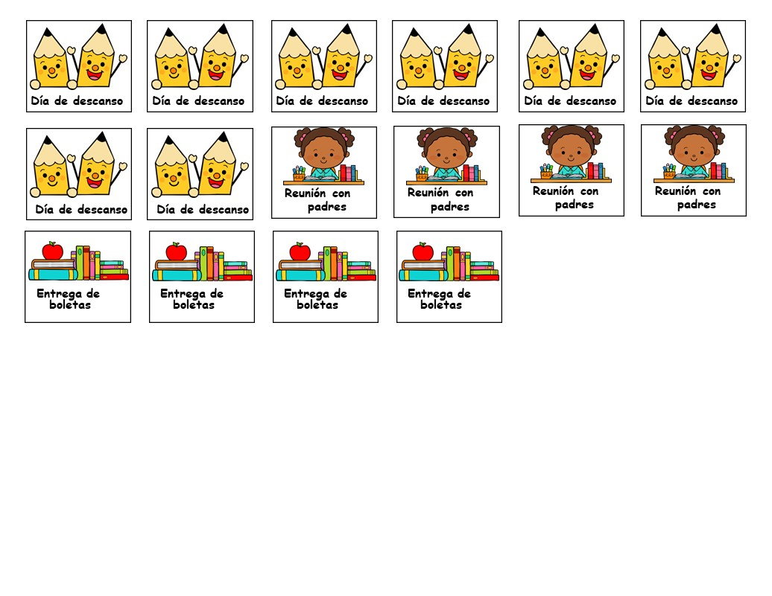

recortables

Slide 9
enero 2027
Lunes | Martes | Miércoles | Jueves | Viernes | Sábado | Domingo
 |  |  |  | 1 | 2 | 3
4 | 5 | 6 | 7 | 8 | 9 | 10
11 | 12 | 13 | 14 | 15 | 16 | 17
18 | 19 | 20 | 21 | 22 | 23 | 24
25 | 26 | 27 | 28 | 29 | 30 | 31

Slide 10
febrero 2027
Lunes | Martes | Miércoles | Jueves | Viernes | Sábado | Domingo
1 | 2 | 3 | 4 | 5 | 6 | 7
8 | 9 | 10 | 11 | 12 | 13 | 14
15 | 16 | 17 | 18 | 19 | 20 | 21
22 | 23 | 24 | 25 | 26 | 27 | 28

Slide 11
marzo 20227
Lunes | Martes | Miércoles | Jueves | Viernes | Sábado | Domingo
1 | 2 | 3 | 4 | 5 | 6 | 7
8 | 9 | 10 | 11 | 12 | 13 | 14
15 | 16 | 17 | 18 | 19 | 20 | 21
22 | 23 | 24 | 25 | 26 | 27 | 28
29 | 30 | 31

Slide 12
abril 2027
Lunes | Martes | Miércoles | Jueves | Viernes | Sábado | Domingo
 |  |  | 1 | 2 | 3 | 4
5 | 6 | 7 | 8 | 9 | 10 | 11
12 | 13 | 14 | 15 | 16 | 17 | 18
19 | 20 | 21 | 22 | 23 | 24 | 25
26 | 27 | 28 | 29 | 30

Slide 13
mAYO 2027
Lunes | Martes | Miércoles | Jueves | Viernes | Sábado | Domingo
 |  |  |  |  | 1 | 2
3 | 4 | 5 | 6 | 7 | 8 | 9
10 | 11 | 12 | 13 | 14 | 15 | 16
17 | 18 | 19 | 20 | 21 | 22 | 23
24 | 25 | 26 | 27 | 28 | 29 | 30
31

Slide 14
JUNIO 2027
Lunes | Martes | Miércoles | Jueves | Viernes | Sábado | Domingo
 | 1 | 2 | 3 | 4 | 5 | 6
7 | 8 | 9 | 10 | 11 | 12 | 13
14 | 15 | 16 | 17 | 18 | 19 | 20
21 | 22 | 23 | 24 | 25 | 26 | 27
28 | 29 | 30

Slide 15
JULIO 2027
Lunes | Martes | Miércoles | Jueves | Viernes | Sábado | Domingo
 |  |  | 1 | 2 | 3 | 4
5 | 6 | 7 | 8 | 9 | 10 | 11
12 | 13 | 14 | 15 | 16 | 17 | 18
19 | 20 | 21 | 22 | 23 | 24 | 25
26 | 27 | 28 | 29 | 30 | 31

Slide 18
recortables

