Slide 1
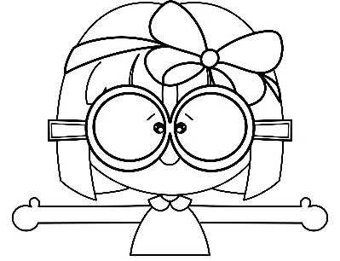
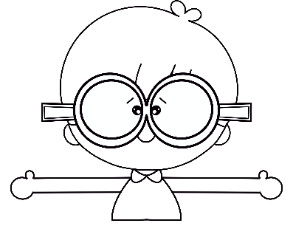

AGOSTO 2022
Lunes | Martes | Miércoles | Jueves | Viernes | Sábado | Domingo
1 | 2 | 3 | 4 | 5 | 6 | 7
8 | 9 | 10 | 11 | 12 | 13 | 14
15 | 16 | 17 | 18 | 19 | 20 | 21
22 | 23 | 24 | 25 | 26 | 27 | 28
29 | 30 | 31

Slide 2
SEPTIEMBRE 2022
Lunes | Martes | Miércoles | Jueves | Viernes | Sábado | Domingo
 |  |  | 1 | 2 | 3 | 4
5 | 6 | 7 | 8 | 9 | 10 | 11
12 | 13 | 14 | 15 | 16 | 17 | 18
19 | 20 | 21 | 22 | 23 | 24 | 25
26 | 27 | 28 | 29 | 30

Slide 3
OCTUBRE 2022
Lunes | Martes | Miércoles | Jueves | Viernes | Sábado | Domingo
 |  |  |  |  | 1 | 2
3 | 4 | 5 | 6 | 7 | 8 | 9
10 | 11 | 12 | 13 | 14 | 15 | 16
17 | 18 | 19 | 20 | 21 | 22 | 23
24 | 25 | 26 | 27 | 28 | 29 | 30
31

Slide 4
NOVIEMBRE 2022
Lunes | Martes | Miércoles | Jueves | Viernes | Sábado | Domingo
 | 1 | 2 | 3 | 4 | 5 | 6
7 | 8 | 9 | 10 | 11 | 12 | 13
14 | 15 | 16 | 17 | 18 | 19 | 20
21 | 22 | 23 | 24 | 25 | 26 | 27
28 | 29 | 30

Slide 5
DICIEMBRE 2022
Lunes | Martes | Miércoles | Jueves | Viernes | Sábado | Domingo
 |  |  | 1 | 2 | 3 | 4
5 | 6 | 7 | 8 | 9 | 10 | 11
12 | 13 | 14 | 15 | 16 | 17 | 18
19 | 20 | 21 | 22 | 23 | 24 | 25
26 | 27 | 28 | 29 | 30 | 31

Slide 6
Enero 2023
Lunes | Martes | Miércoles | Jueves | Viernes | Sábado | Domingo
 |  |  |  |  |  | 1
2 | 3 | 4 | 5 | 6 | 7 | 8
9 | 10 | 11 | 12 | 13 | 14 | 15
16 | 17 | 18 | 19 | 20 | 21 | 22
23 | 24 | 25 | 26 | 27 | 28 | 29
30 | 31

Slide 7
Febrero 2023
Lunes | Martes | Miércoles | Jueves | Viernes | Sábado | Domingo
 |  | 1 | 2 | 3 | 4 | 5
6 | 7 | 8 | 9 | 10 | 11 | 12
13 | 14 | 15 | 16 | 17 | 18 | 19
20 | 21 | 22 | 23 | 24 | 25 | 26
27 | 28

Slide 8
MARZO 2023
Lunes | Martes | Miércoles | Jueves | Viernes | Sábado | Domingo
 |  | 1 | 2 | 3 | 4 | 5
6 | 7 | 8 | 9 | 10 | 11 | 12
13 | 14 | 15 | 16 | 17 | 18 | 19
20 | 21 | 22 | 23 | 24 | 25 | 26
27 | 28 | 29 | 30 | 31

Slide 9
ABRIL 2023
Lunes | Martes | Miércoles | Jueves | Viernes | Sábado | Domingo
 |  |  |  |  | 1 | 2
3 | 4 | 5 | 6 | 7 | 8 | 9
10 | 11 | 12 | 13 | 14 | 15 | 16
17 | 18 | 19 | 20 | 21 | 22 | 23
24 | 25 | 26 | 27 | 28 | 29 | 30

Slide 10
MAYO 2023
Lunes | Martes | Miércoles | Jueves | Viernes | Sábado | Domingo
1 | 2 | 3 | 4 | 5 | 6 | 7
8 | 9 | 10 | 11 | 12 | 13 | 14
15 | 16 | 17 | 18 | 19 | 20 | 21
22 | 23 | 24 | 25 | 26 | 27 | 28
29 | 30 | 31

Slide 11
JUNIO 2023
Lunes | Martes | Miércoles | Jueves | Viernes | Sábado | Domingo
 |  |  | 1 | 2 | 3 | 4
5 | 6 | 7 | 8 | 9 | 10 | 11
12 | 13 | 14 | 15 | 16 | 17 | 18
19 | 20 | 21 | 22 | 23 | 24 | 25
26 | 27 | 28 | 29 | 30

Slide 12
JULIO 2023
Lunes | Martes | Miércoles | Jueves | Viernes | Sábado | Domingo
 |  |  |  |  | 1 | 2
3 | 4 | 5 | 6 | 7 | 8 | 9
10 | 11 | 12 | 13 | 14 | 15 | 16
17 | 18 | 19 | 20 | 21 | 22 | 23
24 | 25 | 26 | 27 | 28 | 29 | 30
31

Slide 13
AGOSTO 2023
Lunes | Martes | Miércoles | Jueves | Viernes | Sábado | Domingo
 | 1 | 2 | 3 | 4 | 5 | 6
7 | 8 | 9 | 10 | 11 | 12 | 13
14 | 15 | 16 | 17 | 18 | 19 | 20
21 | 22 | 23 | 24 | 25 | 26 | 27
28 | 29 | 30 | 31

