Slide 1
^{Horario de clases}
Hora | Lunes | Martes | Miércoles | Jueves | Viernes

Slide 2
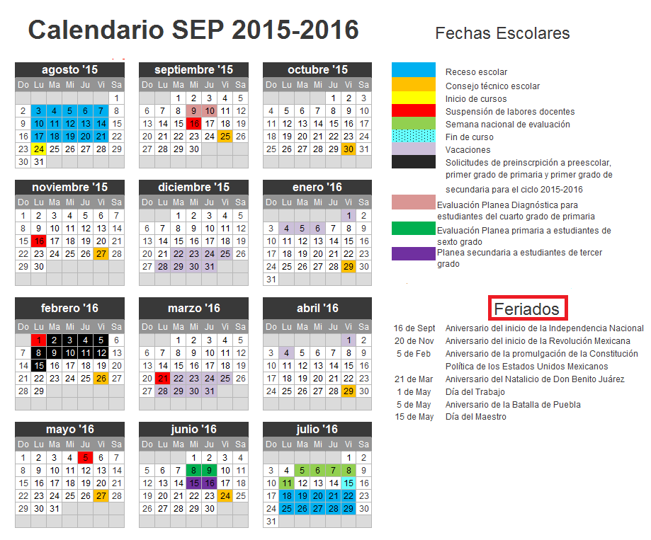

Slide 3
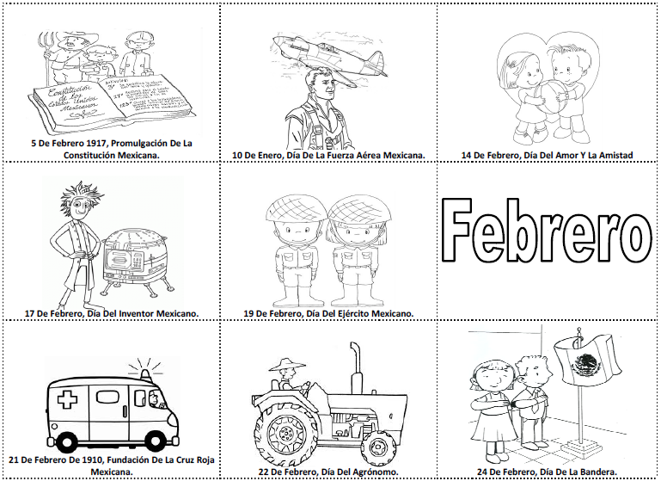
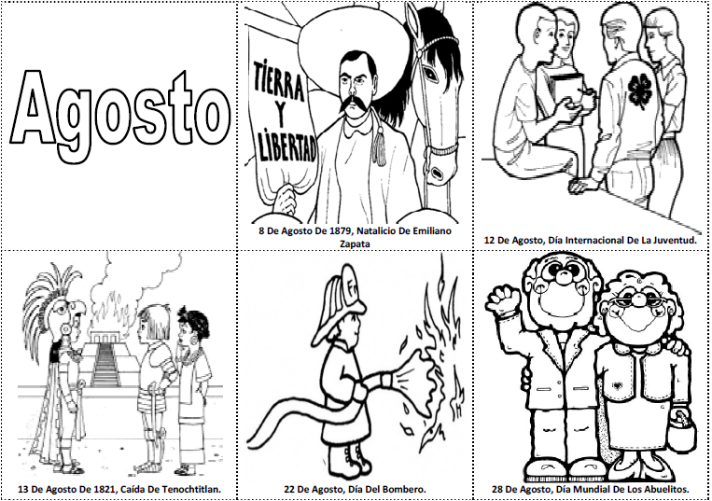
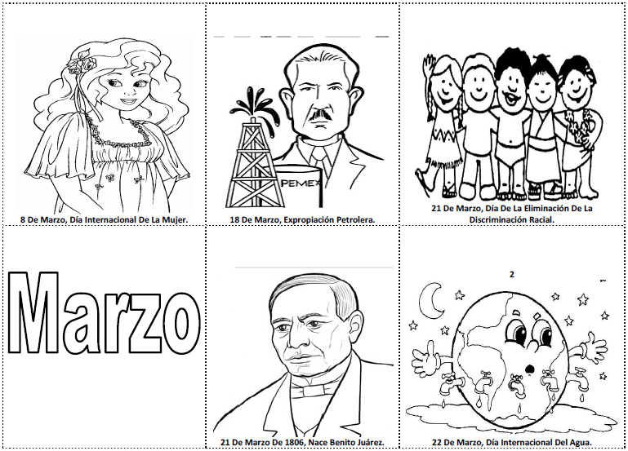
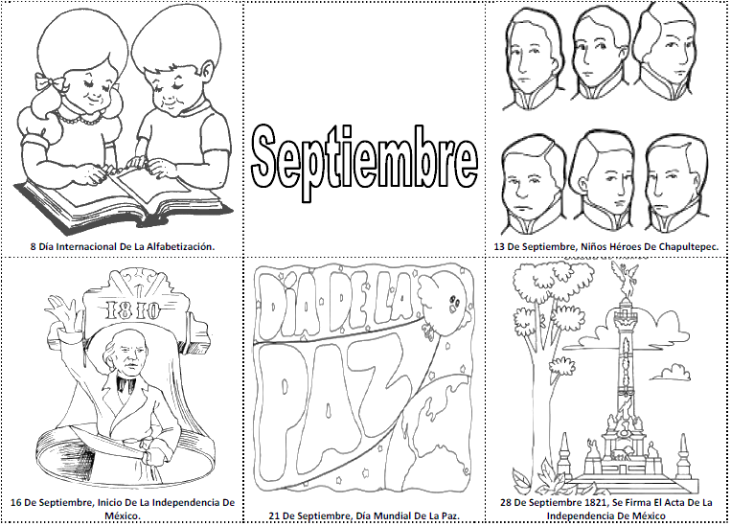

Slide 4
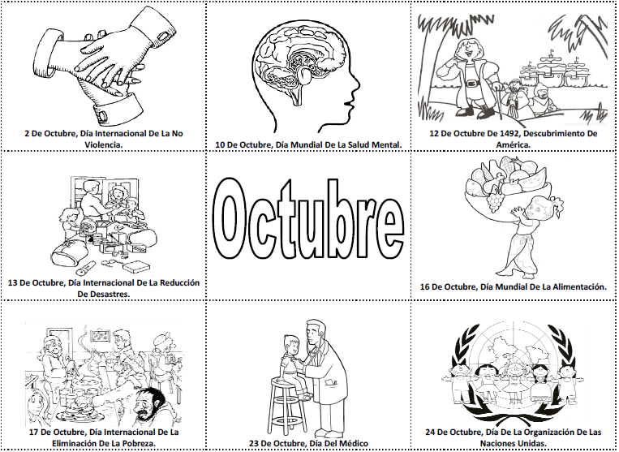
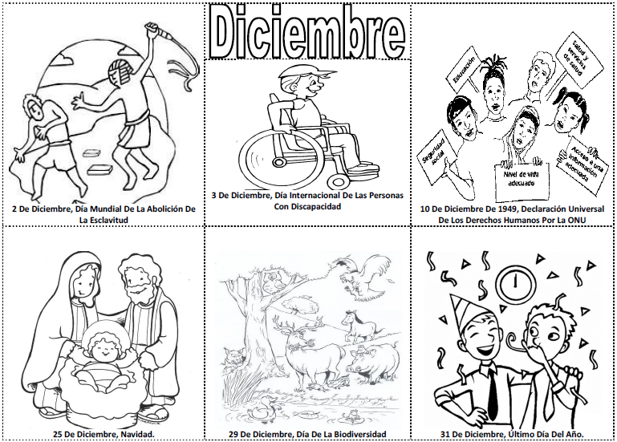
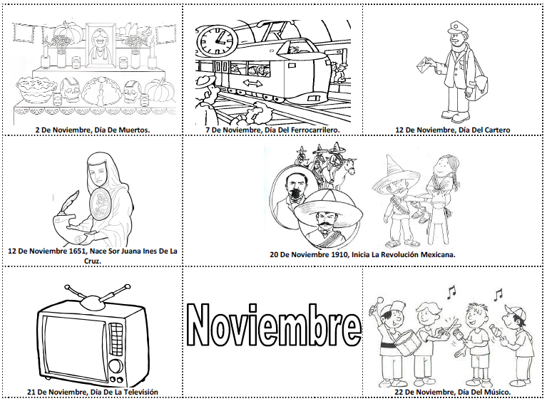
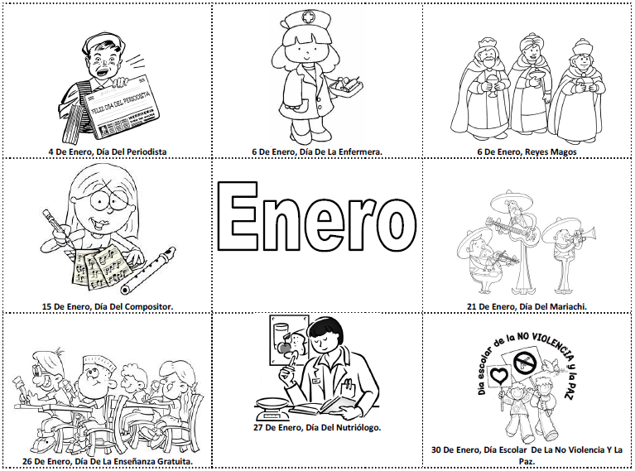

Slide 5
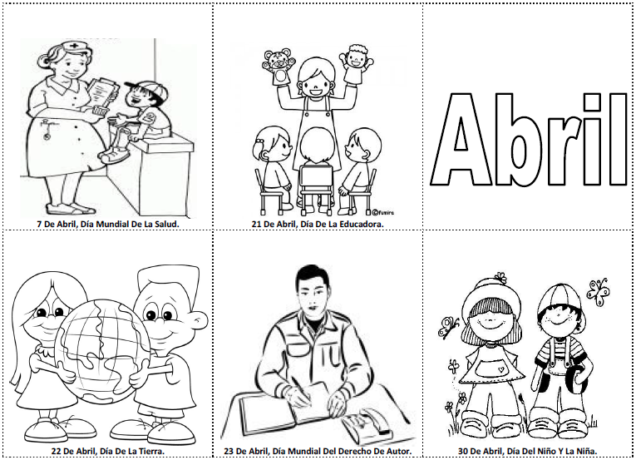
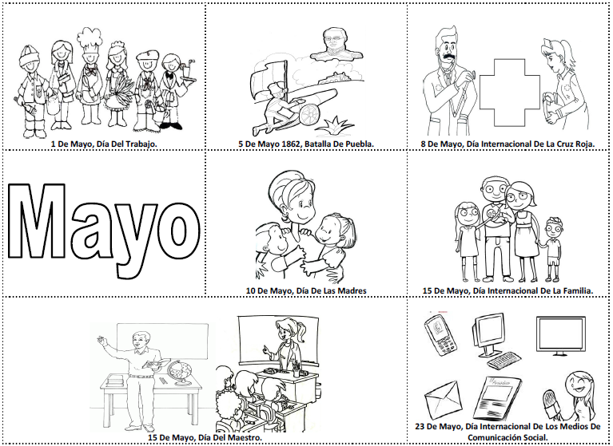
Notas
____________________________________________________________________________________________________________________________________________________________________________________________________________________________________________________________________________________________________________________________________________________________________________________
_______________________________
_______________________________
________________________
________________________
________________________

Slide 6
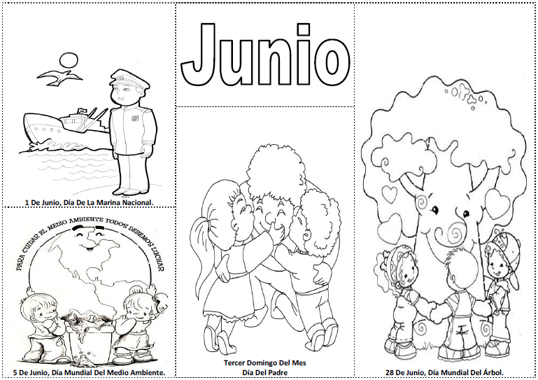
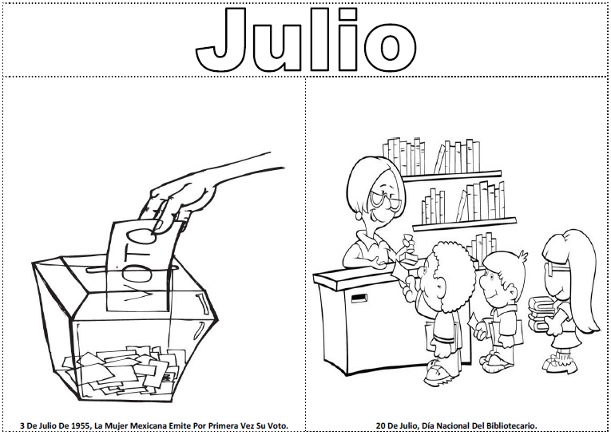
Bimestre | Recepción de cuadros | Entrega de cuadros | Junta con padres de familia
1º
2º
3º
4º
5º

Slide 7
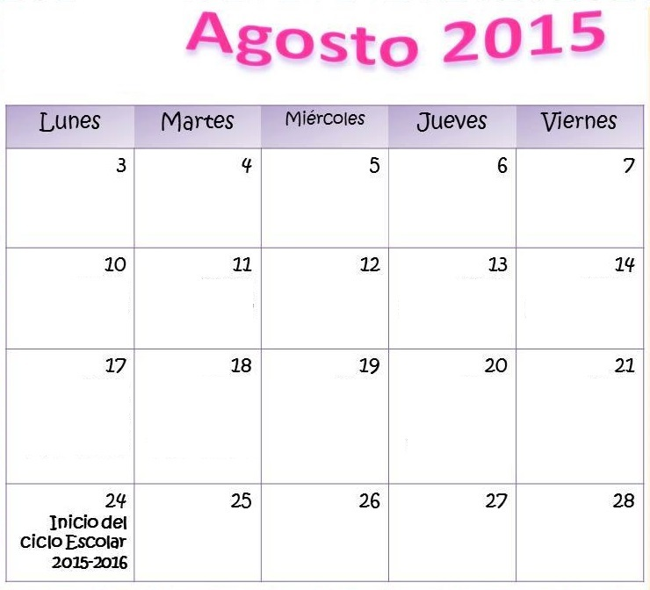
Consejo Técnico
Escolar
____________________________________________________________________________________________________________________________________________________________________________________________________________________________________________________________________________________________________________________________________________________________________________________
_______________________________
_______________________________
________________________
________________________
________________________

Slide 8
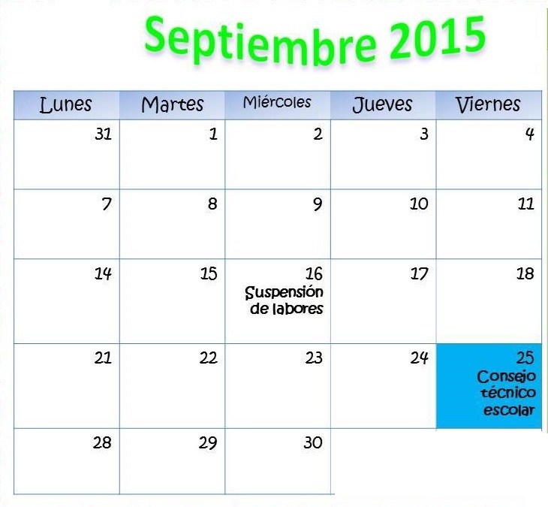
Consejo Técnico
Escolar
____________________________________________________________________________________________________________________________________________________________________________________________________________________________________________________________________________________________________________________________________________________________________________________
_______________________________
_______________________________
________________________
________________________
________________________

Slide 9
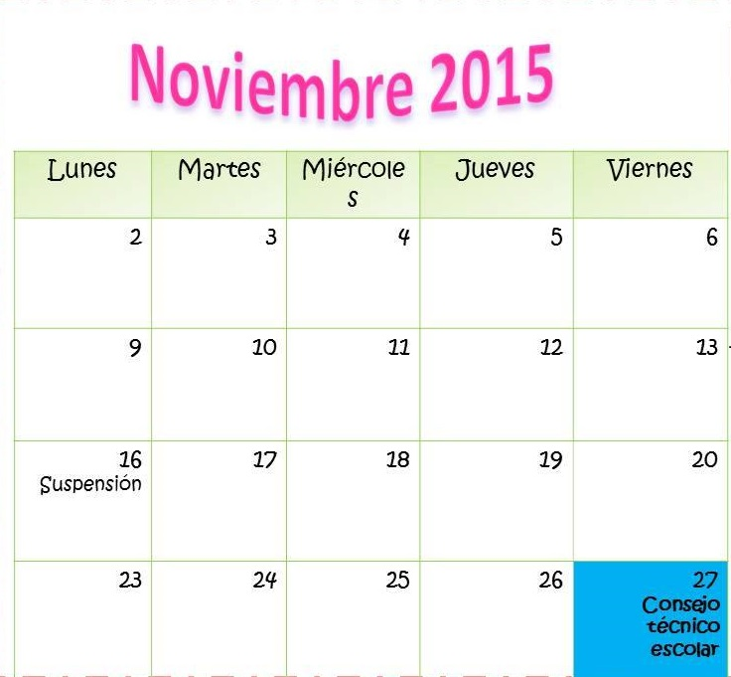
Consejo Técnico
Escolar
____________________________________________________________________________________________________________________________________________________________________________________________________________________________________________________________________________________________________________________________________________________________________________________
_______________________________
_______________________________
________________________
________________________
________________________

Slide 10
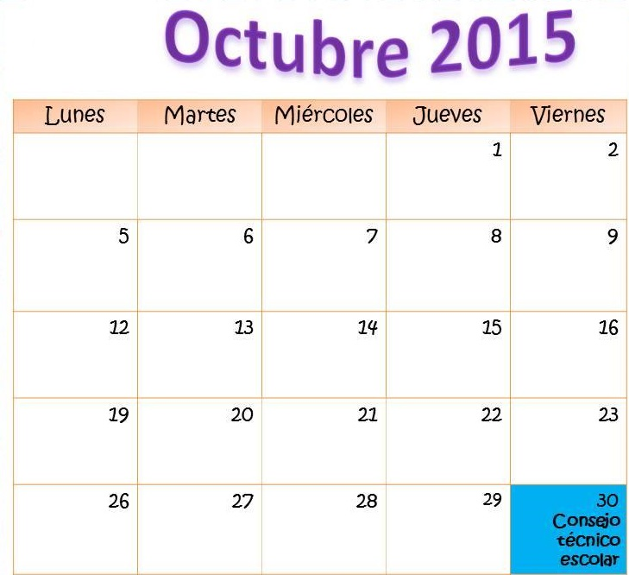
Consejo Técnico
Escolar
____________________________________________________________________________________________________________________________________________________________________________________________________________________________________________________________________________________________________________________________________________________________________________________
_______________________________
_______________________________
________________________
________________________
________________________

Slide 11
Consejo Técnico
Escolar
Consejo Técnico
Escolar
____________________________________________________________________________________________________________________________________________________________________________________________________________________________________________________________________________________________________________________________________________________________________________________
_______________________________
_______________________________
________________________
________________________
________________________
____________________________________________________________________________________________________________________________________________________________________________________________________________________________________________________________________________________________________________________________________________________________________________________
_______________________________
_______________________________
________________________
________________________
________________________

Slide 12
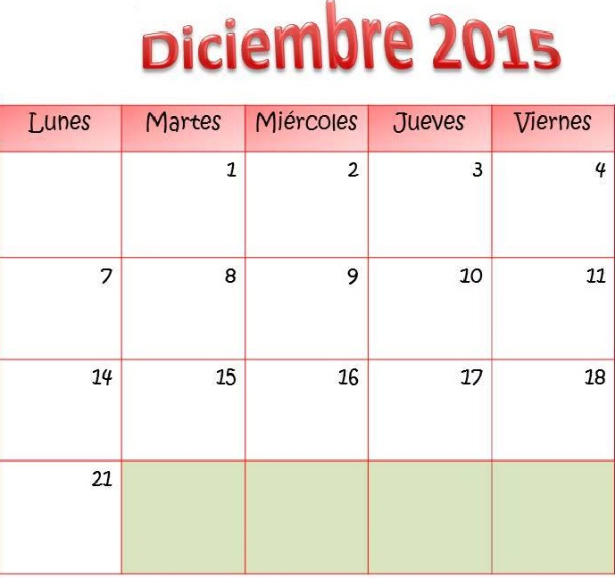
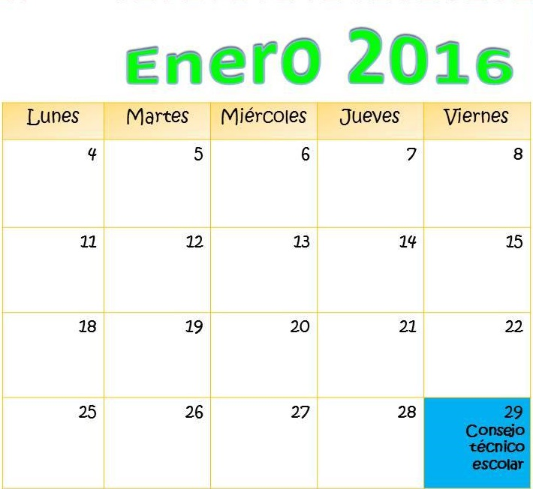

Slide 13
Consejo Técnico
Escolar
Consejo Técnico
Escolar
____________________________________________________________________________________________________________________________________________________________________________________________________________________________________________________________________________________________________________________________________________________________________________________
_______________________________
_______________________________
________________________
________________________
________________________
____________________________________________________________________________________________________________________________________________________________________________________________________________________________________________________________________________________________________________________________________________________________________________________
_______________________________
_______________________________
________________________
________________________
________________________

Slide 14
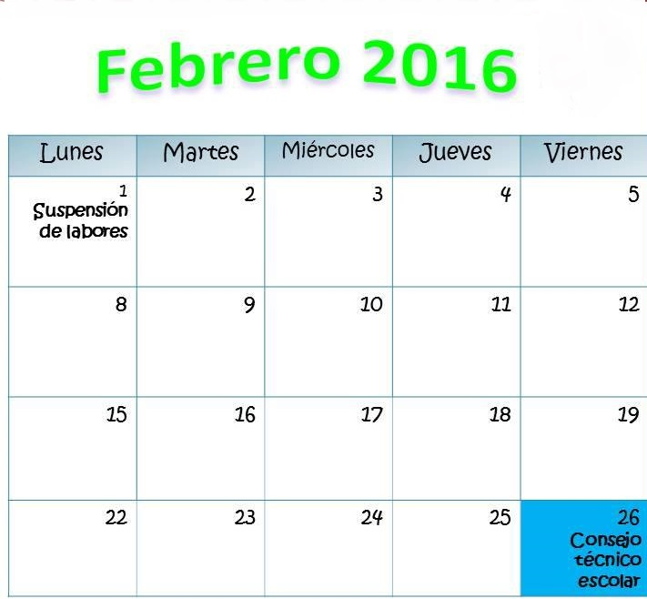
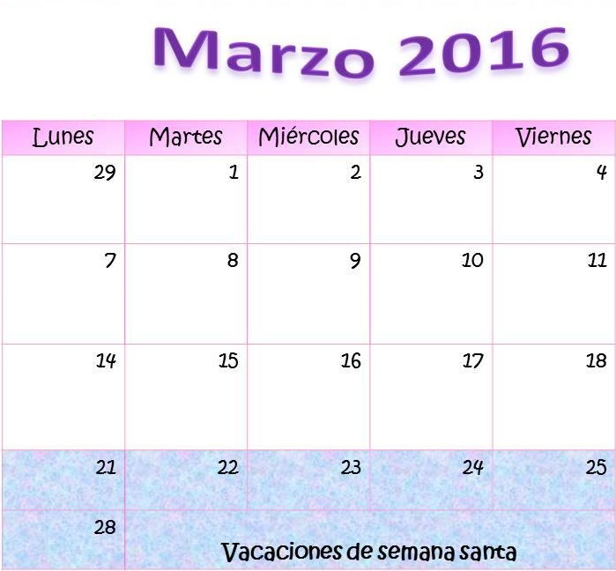

Slide 15
Consejo Técnico
Escolar
Consejo Técnico
Escolar
____________________________________________________________________________________________________________________________________________________________________________________________________________________________________________________________________________________________________________________________________________________________________________________
_______________________________
_______________________________
________________________
________________________
________________________
____________________________________________________________________________________________________________________________________________________________________________________________________________________________________________________________________________________________________________________________________________________________________________________
_______________________________
_______________________________
________________________
________________________
________________________

Slide 16
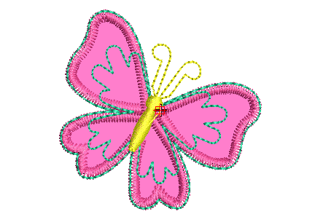
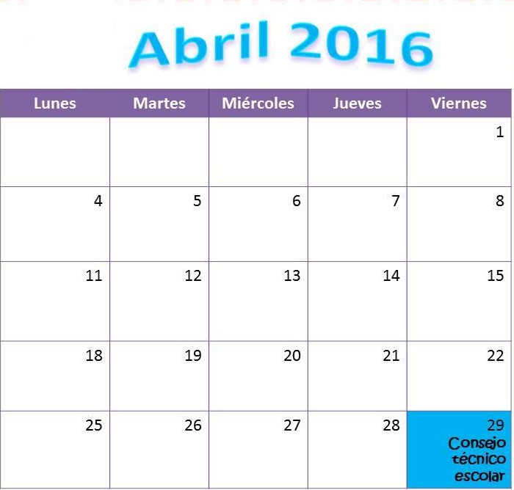
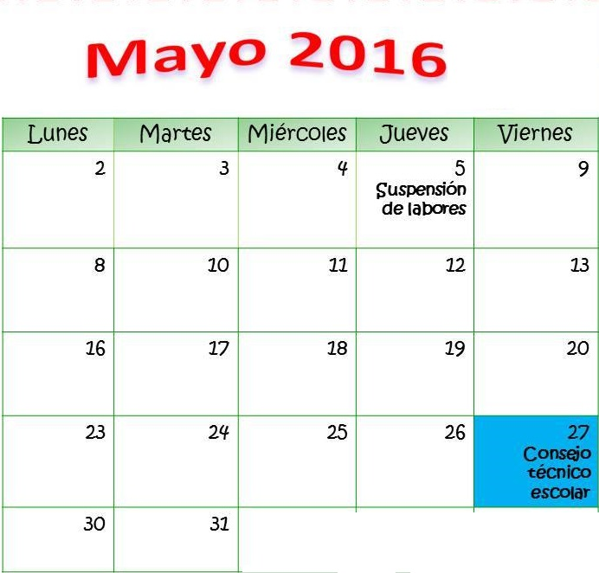

Slide 17
Consejo Técnico
Escolar
Consejo Técnico
Escolar
____________________________________________________________________________________________________________________________________________________________________________________________________________________________________________________________________________________________________________________________________________________________________________________
_______________________________
_______________________________
________________________
________________________
________________________
____________________________________________________________________________________________________________________________________________________________________________________________________________________________________________________________________________________________________________________________________________________________________________________
_______________________________
_______________________________
________________________
________________________
________________________

Slide 18
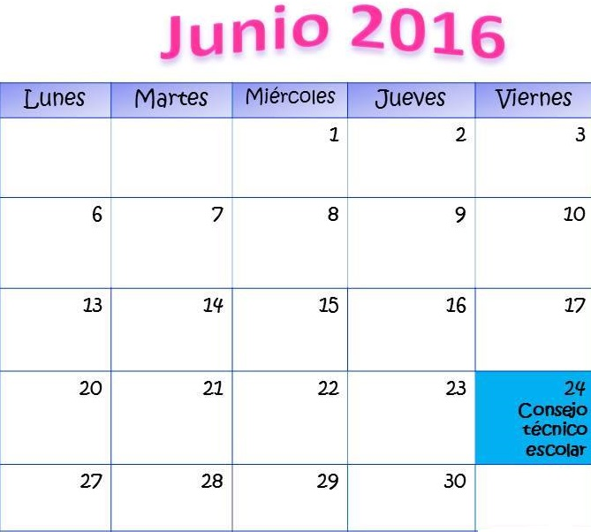
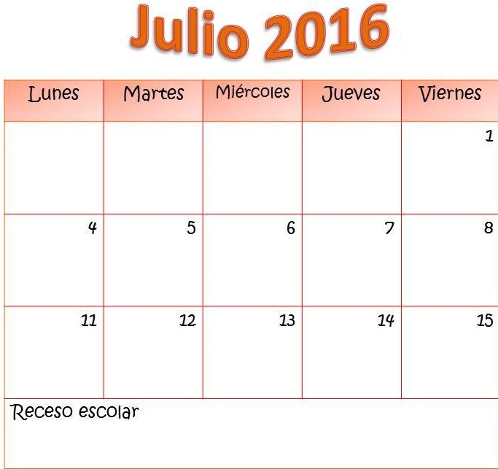

Slide 19
Notas
____________________________________________________________________________________________________________________________________________________________________________________________________________________________________________________________________________________________________________________________________________________________________________________
_______________________________
_______________________________
________________________
________________________
________________________

Slide 20
Notas
Notas
____________________________________________________________________________________________________________________________________________________________________________________________________________________________________________________________________________________________________________________________________________________________________________________
_______________________________
_______________________________
________________________
________________________
________________________
_______________________________________________________________________________________________________________________________________________________________________________________________________________________________________________________________________________________________________________________________________________________________________________________________________________________________________________________________________________________________
________________________

